Slide 1
Computational Chemistry Methods
Lecture – 6

Slide 2
CONTENTS
Computational Chemistry Methods
○ Ab Initio Methods
○ Density Functional Methods
○ Semi-empirical Methods

Slide 3
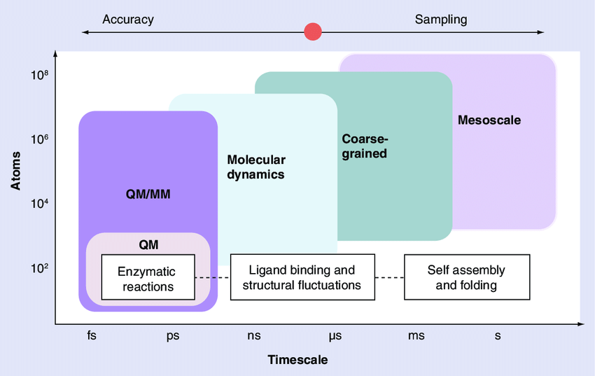
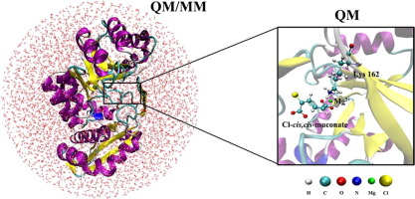
Definition
The main objective of computational chemistry is to solve chemical problems by simulating chemical systems (molecular, biological, materials) in order to provide reliable, accurate and comprehensive information at an atomic level.
To this end, there are two main methodological families: those based on quantum chemical methods and those based on molecular mechanics.
The former are methods in which the electrons are explicitly accounted for, while in the latter their presence is hidden in the force field.

Slide 4
Computational Chemistry Methods
Classical Methods
Quantum chemistry method

Slide 5
Classical Methods
Are those method use Newton mechanics to model molecular system. • Quantum chemistry method:- Which makes use of Quantum mechanics to model the molecular system. This method used different type of approximation to solve Schrödinger’s Equation.
Molecular Mechanics
Molecular Dynamics
Quantum chemistry method:-
Which makes use of Quantum mechanics to model the molecular system. This method used different type of approximation to solve Schrödinger’s Equation.
Quantum Mechanics Methods
Semi empirical Methods.
Ab initio Methods.
Density functional Theory.

Slide 6
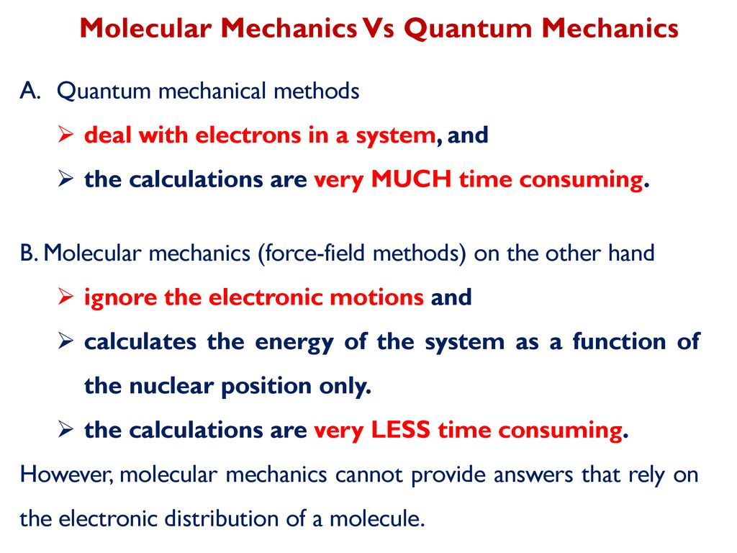

Slide 7
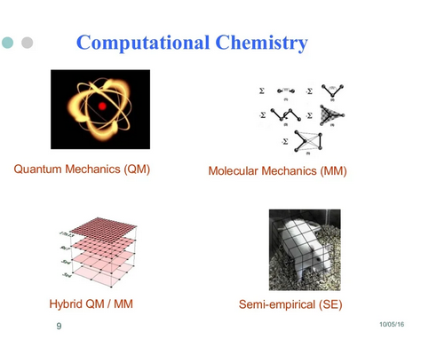

Slide 8
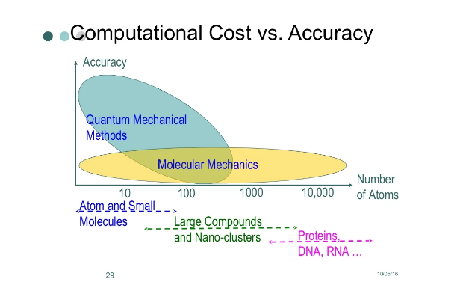

Slide 9


